Slide 1
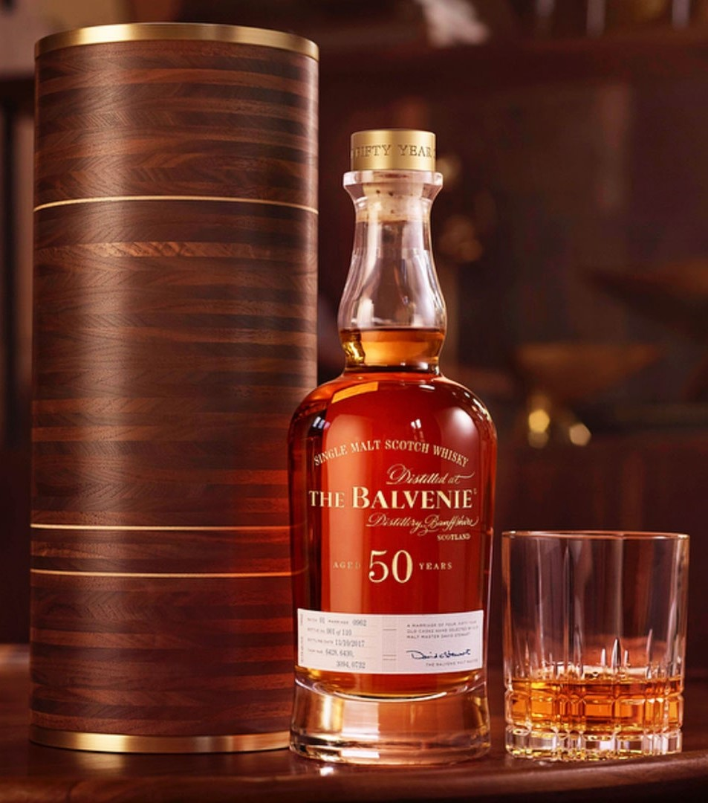
DRINKS and COCKTAILS RECOMMENDATION SYSTEM
Steven L Truong
Friday 05/27/2021

Slide 2
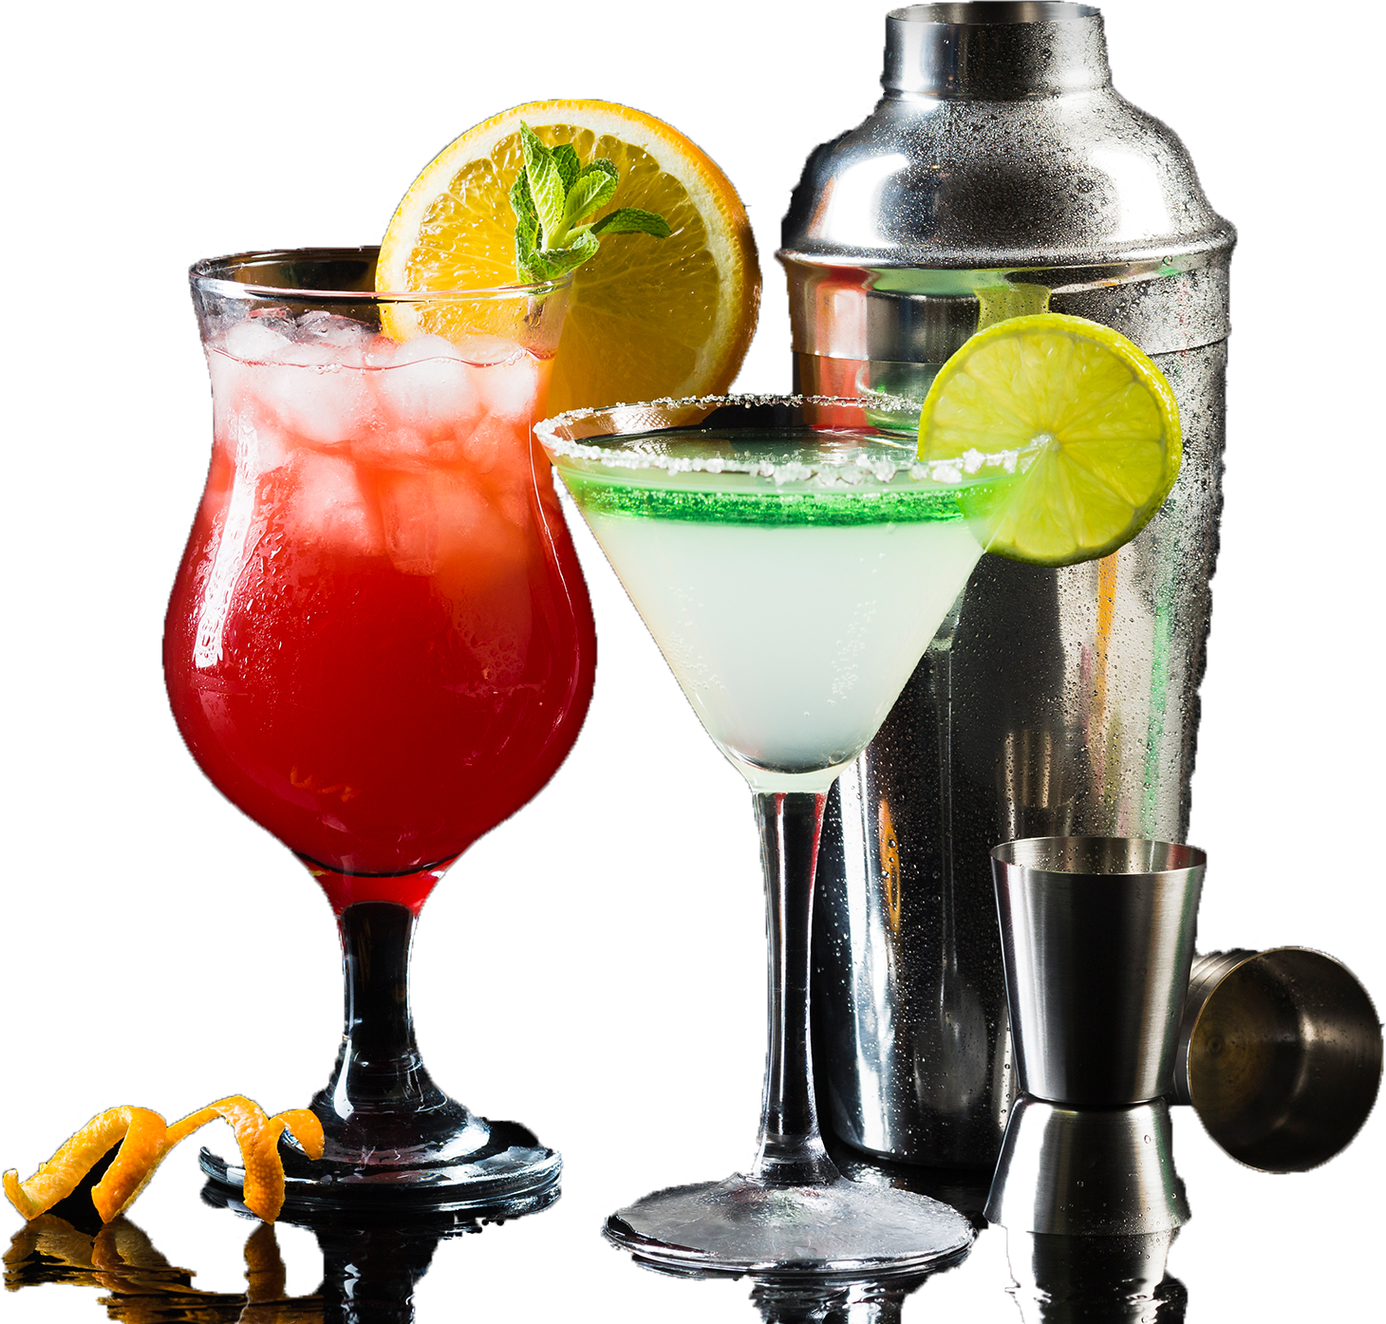
MOTIVATION

Slide 3


Slide 4
WORKFLOW

Slide 5
WORKFLOW
DATA
Scrape data and API calling

Slide 6
WORKFLOW
DATA
EDA
Scrape data and API calling
Visualize the data and sentiment analysis

Slide 7
WORKFLOW
DATA
EDA
TOPIC MODELING
Scrape data and API calling
Visualize the data and sentiment analysis
TF-IDF Vectorizer and NMF(15)

Slide 8
WORKFLOW
DATA
EDA
TOPIC MODELING
REC-SYS
Scrape data and API calling
Visualize the data and sentiment analysis
TF-IDF Vectorizer and NMF(15)
Take user’s input and recommend the most relevant products

Slide 9
WORKFLOW
DATA
EDA
TOPIC MODELING
REC-SYS
DEPLOYMENT
Scrape data and API calling
Visualize the data and sentiment analysis
TF-IDF Vectorizer and NMF(15)
Take user’s input and recommend the most relevant products
Build streamlit app and deploy to share.streamlit

Slide 10

DATA GATHERING
Scraped from multiple sources and API calling

Slide 11
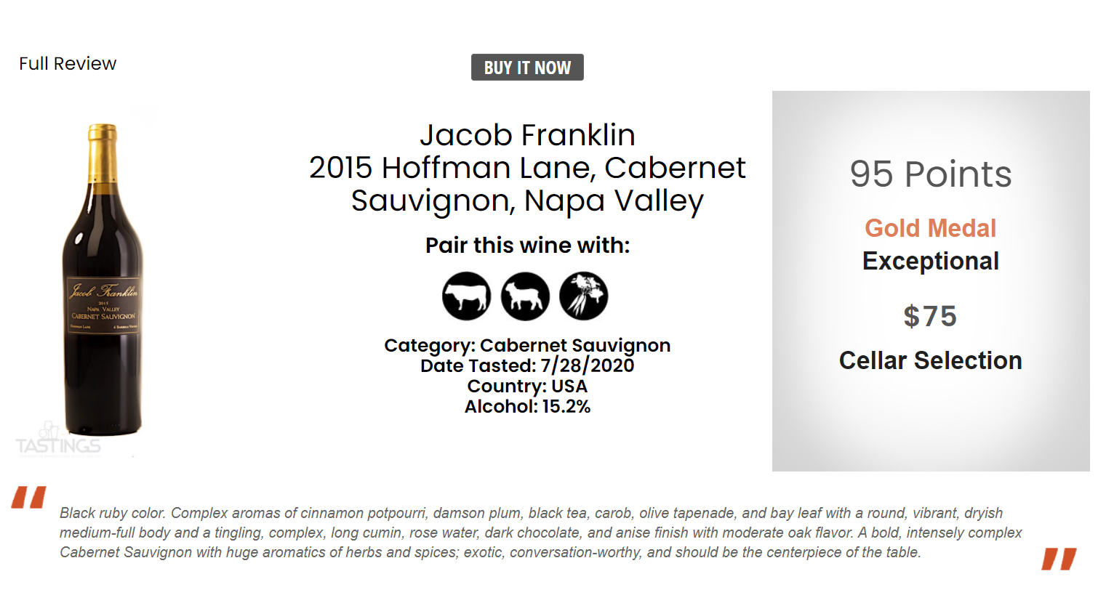

Slide 13
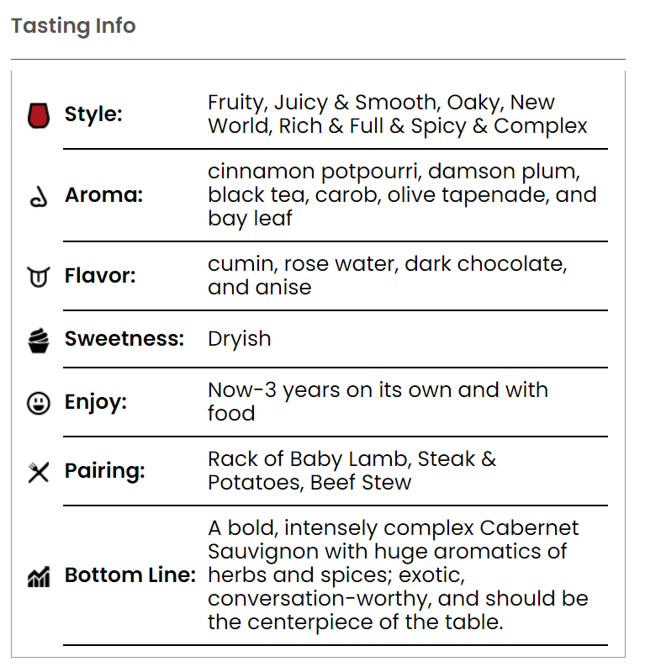
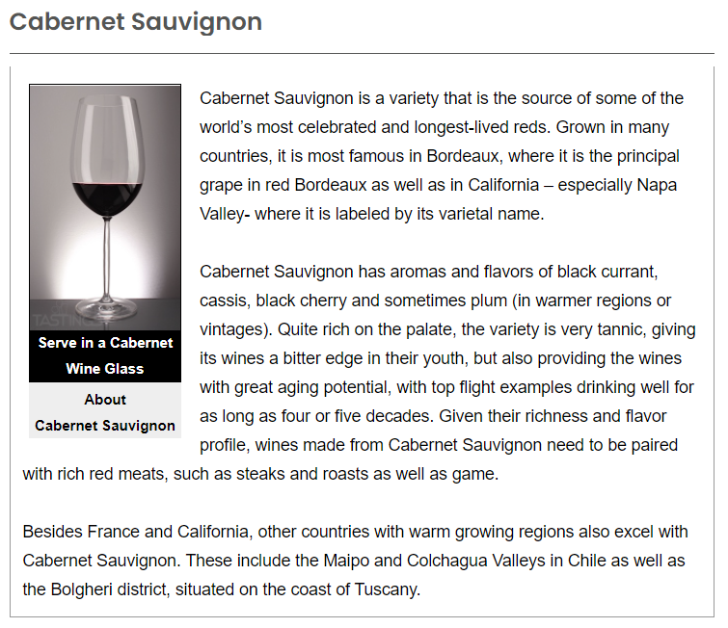

Slide 14

Exploratory data analysis
EDA and sentiment analysis

Slide 15
EDA and Sentiment Analysis

Slide 16
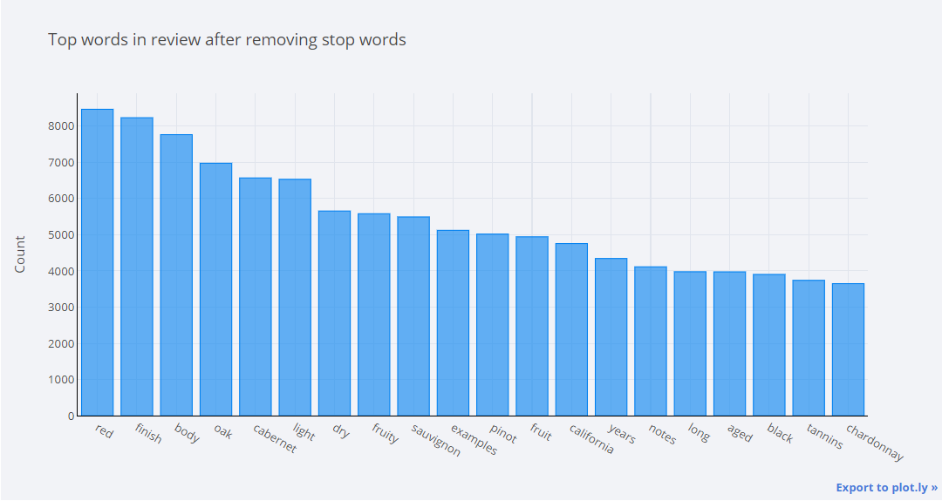
EDA and Sentiment Analysis

Slide 17
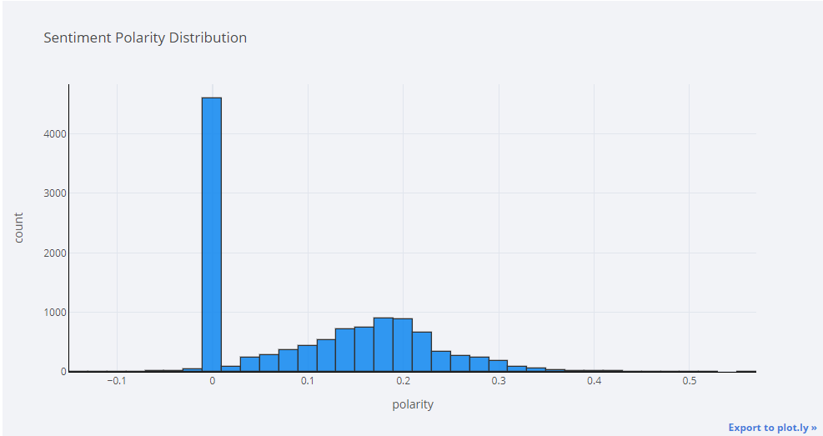
EDA and Sentiment Analysis

Slide 18
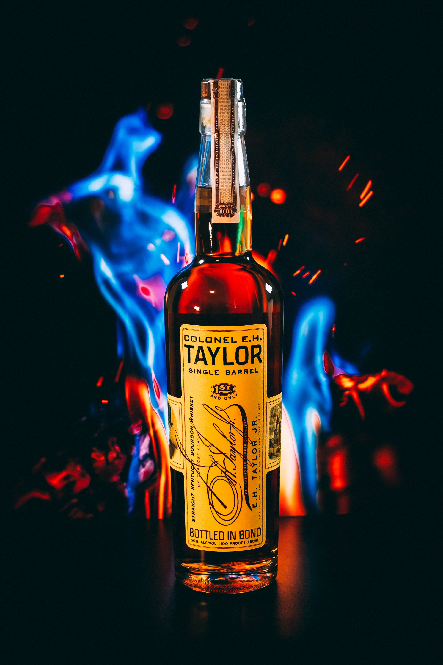
Topic Modeling
TF-IDF Vectorizer and NMF(15 components)

Slide 19
Coherence Scores

Slide 20
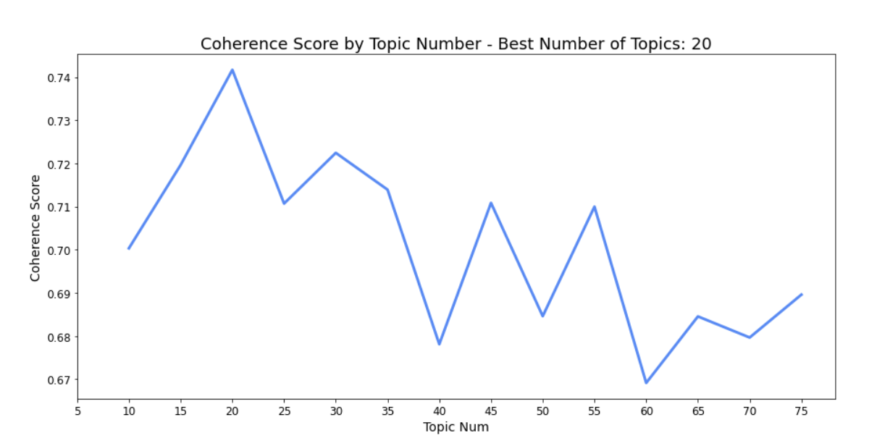
Coherence Scores

Slide 21
Coherence Scores
0.741
0.722

Slide 22

15 topics

Slide 23
15 topics
Based on type and flavor of alcohols

Slide 24

List of topics
Cheap, affordable, good value
Bittering hop IPA
White and spiced Rum
Oaky, fruity Red blend and Merlot
Dried sour cherries flavored Pinot Noir
Sweet and fruity cider
Dry and oaky Chardonnay
Non-smoky, sweet Rose
Fruity Sauvignon Blanc
Straight and flavored Vodka
Whiskey (Bourbon and Scotch)
Sweet, light, and corn beer
Smooth and dry tequila
Cocktail mixers (ready-to-drink cocktails)
Dry Gin

Slide 25
Cheap, affordable, good value

Slide 26
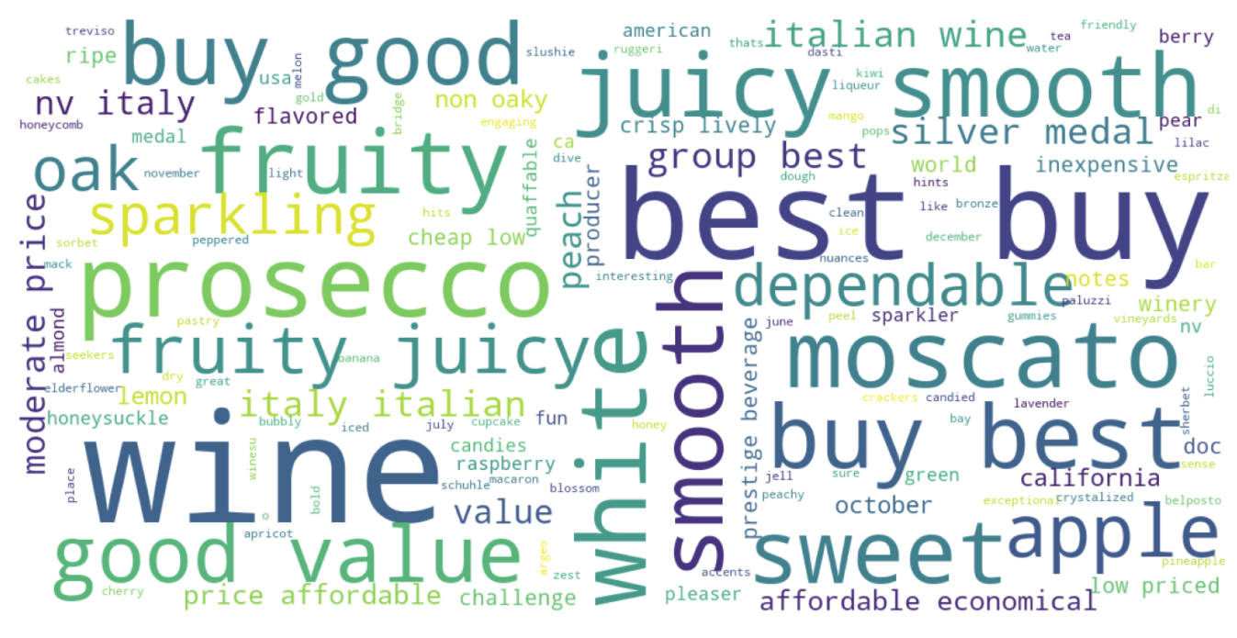
Cheap, affordable, good value

Slide 27
Whiskey, bourbon with rich flavor

Slide 28
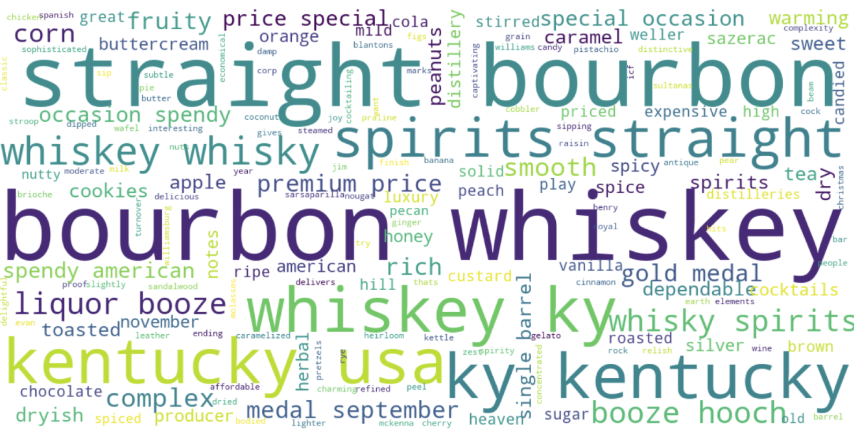
Whiskey, bourbon with rich flavor

Slide 29
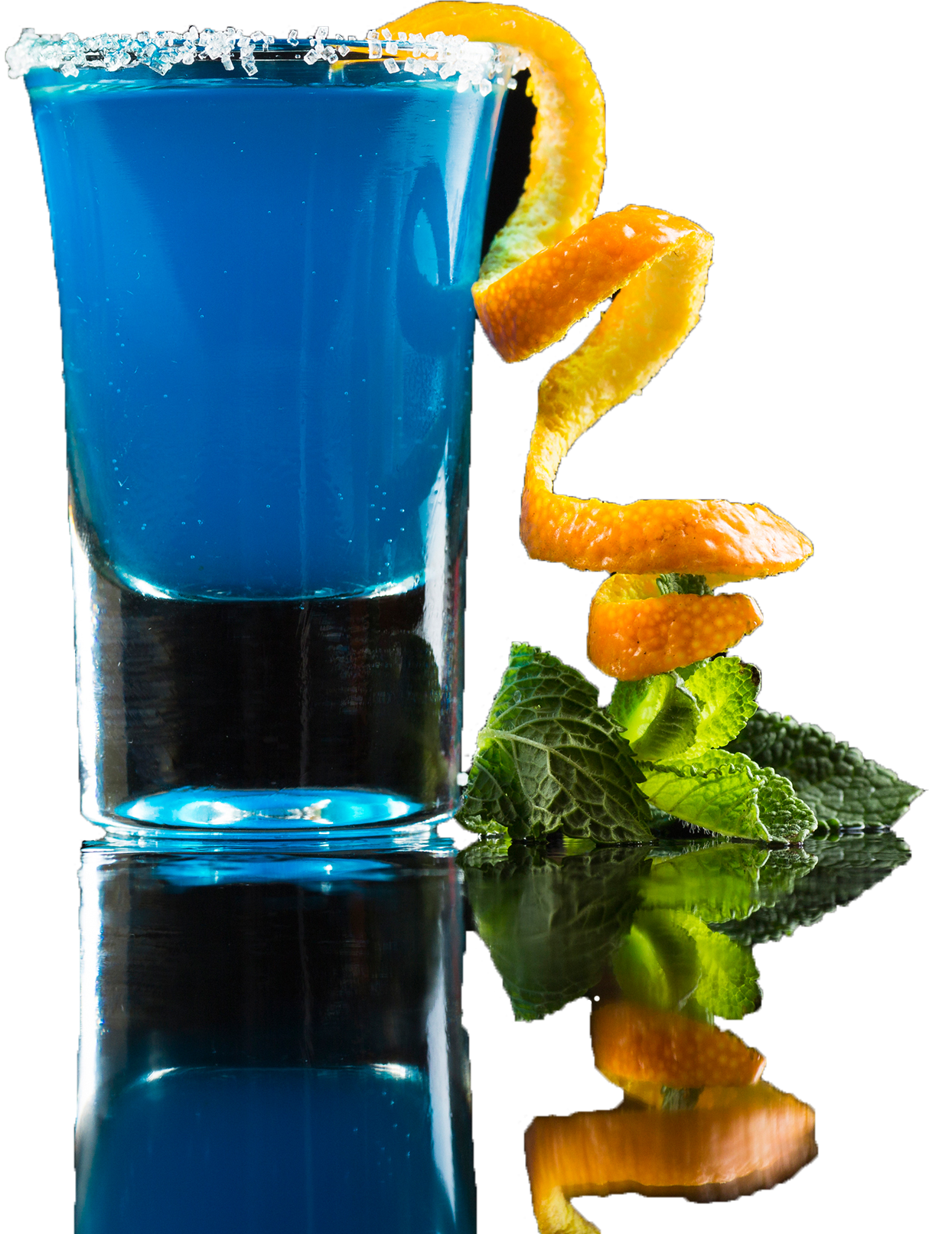
Recommendation System Application Deployment
Build content-based rec-sys and deploy it to streamlit

Slide 30
How the system works

Slide 31
How the system works
USER INPUT
Text field for user input (description, ingredients, etc.)

Slide 32
How the system works
USER INPUT
TF-IDF / NMF
Text field for user input (description, ingredients, etc.)
TF-IDF transform, then NMF transform, calculate cosine similarity

Slide 33
How the system works
USER INPUT
TF-IDF / NMF
RECOMMENDATION
Text field for user input (description, ingredients, etc.)
TF-IDF transform, then NMF transform, calculate cosine similarity
Return the most similar products (with some randomness)

Slide 34

DEMONSTRATION
How do we know that our system work? Let’s see it in action!

Slide 35

FUTURE WORK
ALGORITHMS
Try other clustering algorithms (K-means, DBSCAN)
Optimize the recommendation system (use more num_topics/dimensions)
DATA
Gather more data to recommend users.

Slide 36

THANK YOU
Steven L Truong
Please reach out to me at https://www.linkedin.com/in/luongtruong77/

Slide 37

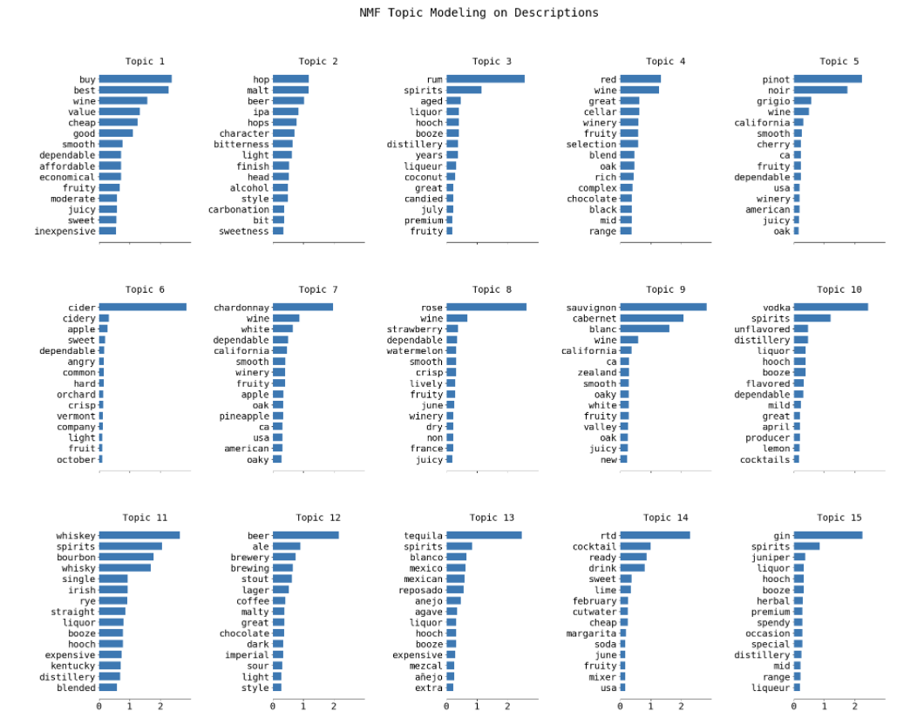
Appendix

Slide 38
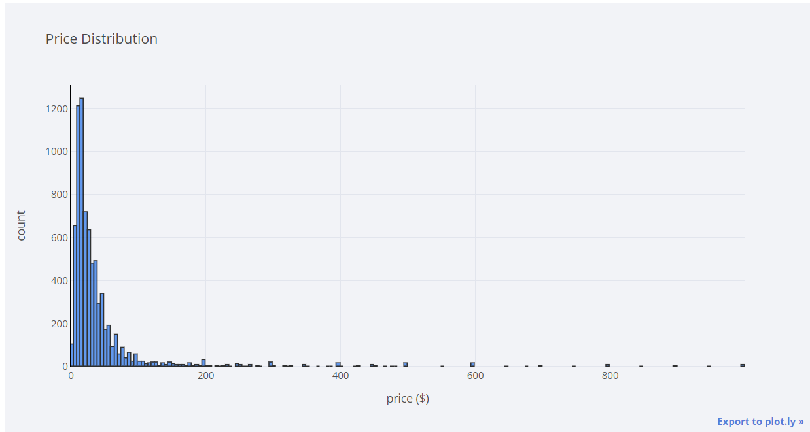
Appendix

Slide 39
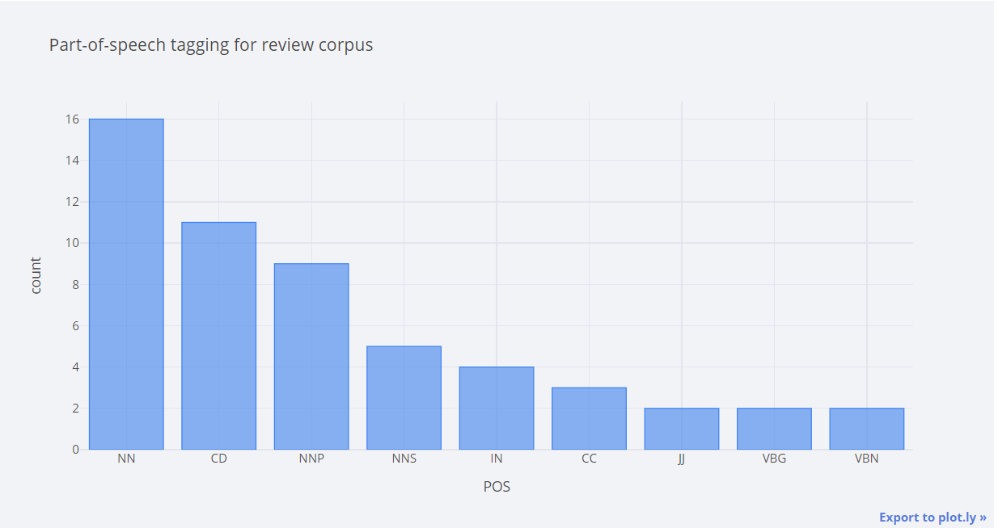
Appendix

Slide 40
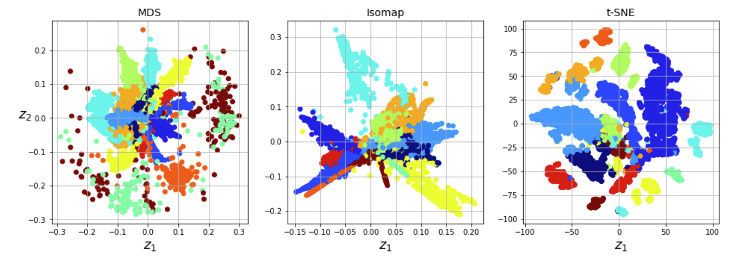
Appendix

Slide 41
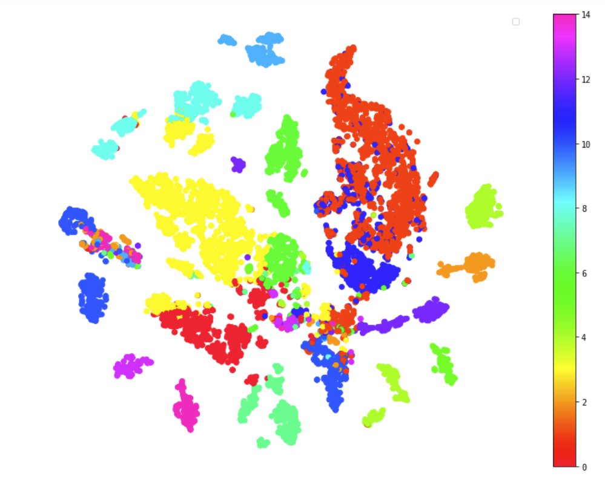
Appendix

Slide 42
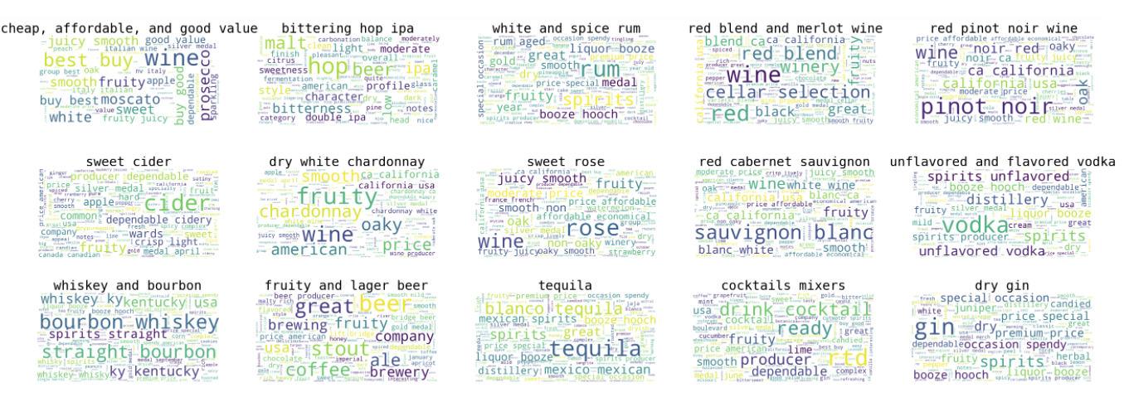
Appendix

